Slide 1
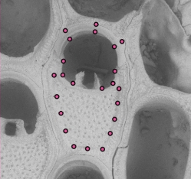
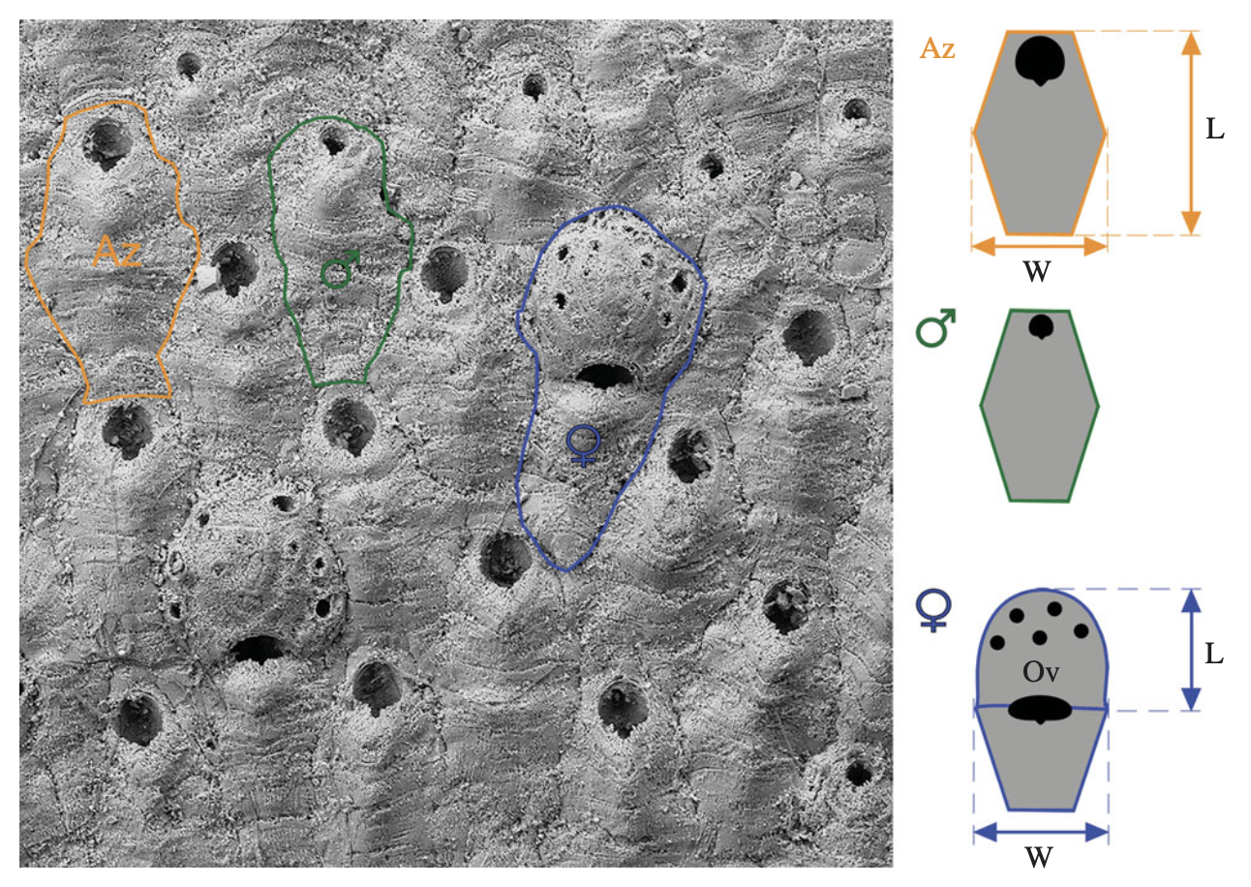
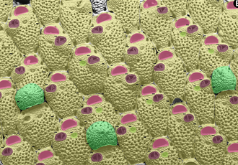


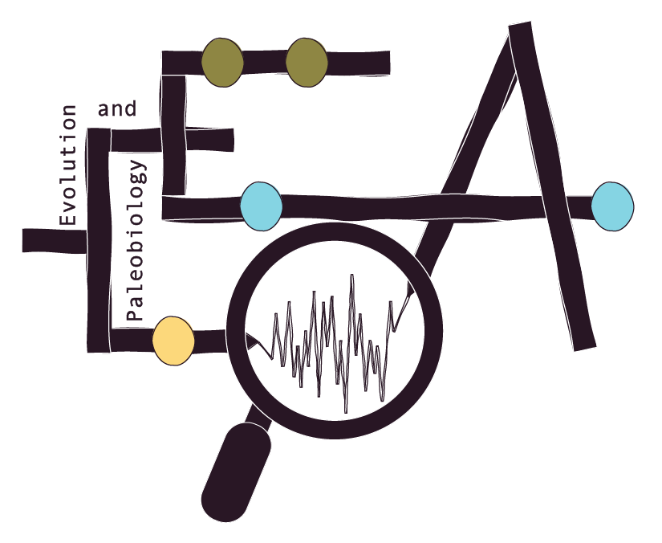

Machine learning
meets
museum collections
Background
Bryozoans are species made up of genetically identical zooids. Bryozoa can have modularized colonies made up of different zooid type (e.g., autozooid, A and B zooids, avicularia, gastrozooid, etc.). Their clonal nature and modularization makes them an ideal group to explore evolutionary questions about phenotypic change.
Bryozoans are composed of zooids, individual units which may have different functions. For example, some zooids are for feeding and some for reproduction.
Zooids within a colony are genetically idenetical. That means that the same genetic variation produces a wide range of phenotypic variation. Knowing their relatedness means that we can apply modern quantitative methods on both fossil and modern bryozoans.
We are interested in looking at how these different zooids change in size and shape over time and across the Bryozoan tree. In order to do this, we need A LOT of data.
Shakespeare Group
SHCSBSB
Materials
We have collected bryozoan fossils from the Whanganui Basin on the North Island of New Zealand (Fig. 1).
The species of interest are Microporella (Fig. 2) and Antarctothoa (Fig. 3). Both species have different zooids, or modules, to explore how size and shape relationships change over time and across module.
Tainui
0
Figure 5. SEM image of a Steginoporella specimen with landmarks placed by the ML-Morph program on a zooid.
Upper
Kai-Iwi
Kai-Iwi Group
0.5
Okehu Group
Pleistocene
1.0
1.5
Quaternary
Maxwell Group
2.0
Methods
We will collect linear morphological data (Fig. 4) on 1000s of zooids from 100s of colonies. To expedite trait extraction, we will use DeepBryo to detect individual zooids and their parts and use ML-Morph to apply landmarks (Fig. 5) to extract measurements (Fig. 4).
The machine learning programs will need some retraining. The student will use the programs to annotate SEM images (e.g., Figs. 3 and 4).
The student can also have the opportunity to prepare and SEM the fossils, given they have completed lab safety courses.
Nukumaru Group
Tewkesbury
Pliocene
NKBS
2.5
NKLS
3.0
Figure 1. temporal span of formations from which the fossils were collected.
Figure 3. SEM image of a Antarctothoa specimen with the three zooid types (autozooid, female zooid, and male zooid) outlined.
Figure 2. Image of a Microporella colony with parts (avicularia, orifice, crypotcyst, ovicell) identified by DeepBryo.
Outcomes
The student will:
Learn machine learning programs
Learn about the fossil record
Learn how to use GitHub and work in a collaborative environment
Learn data management skills
Learn about morphology
Possibly learn how to prepare and image specimens
Figure 4. Morphological measurements of zooids to be extracted from the landmarks placed by ML-morph.
Meghan A. Balk, Ph.D.
Postdoctoral Fellow

Slide 2
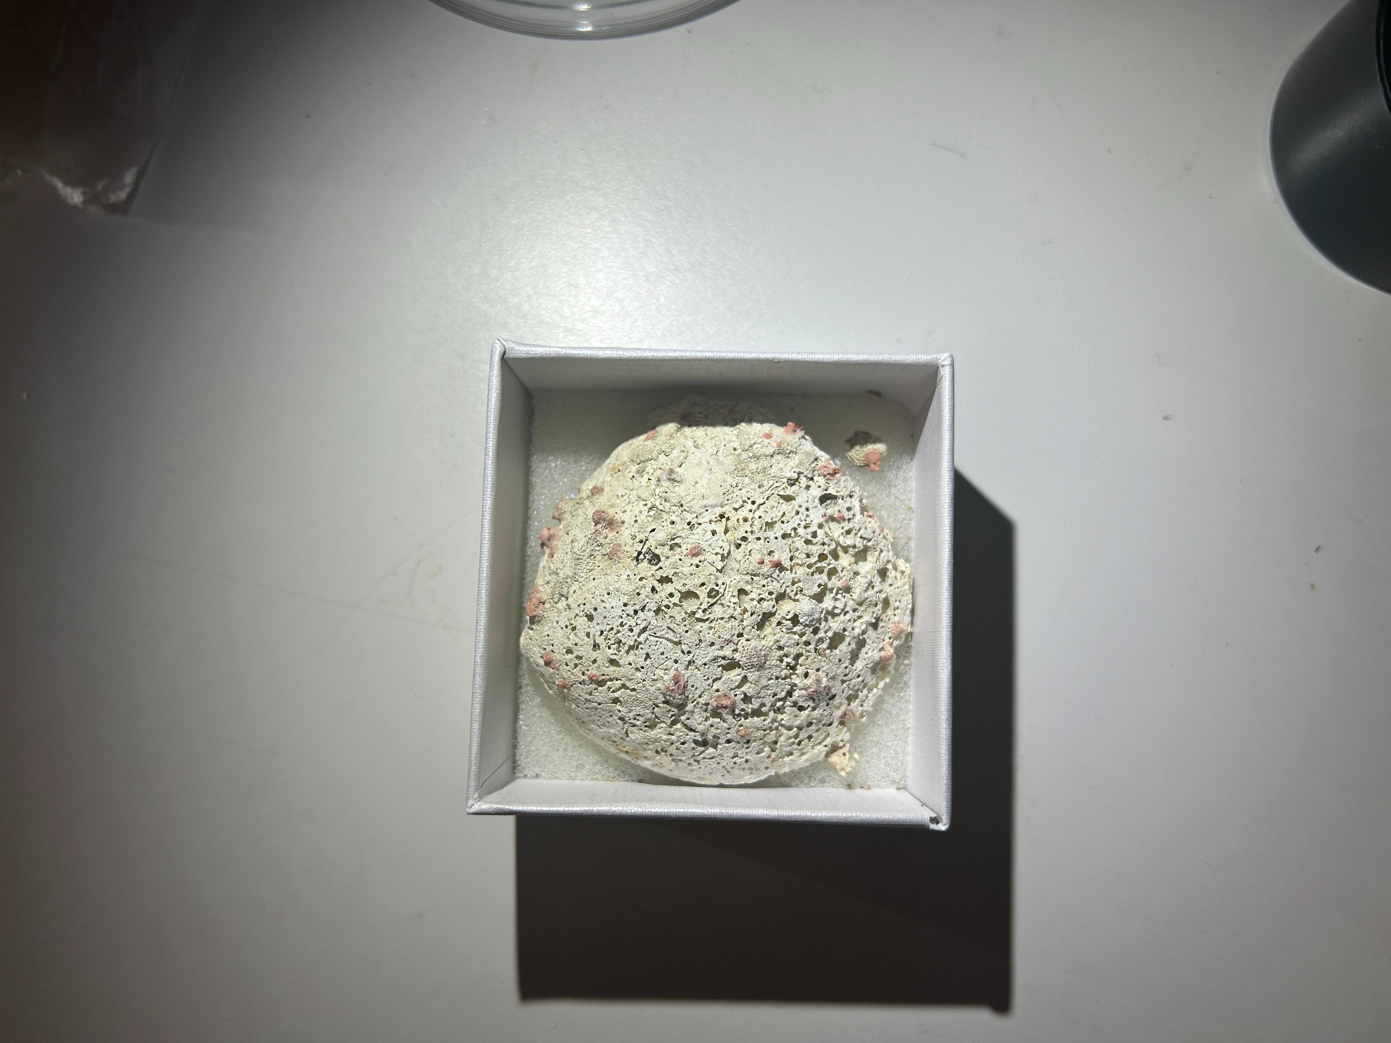
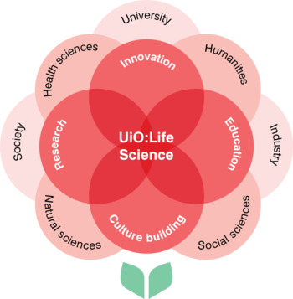
TITLE
Lily Sandstrom, Meghan A. Balk, Kjetil L. Voje
INTRO/BACKGROUND
Why are we interested
What has been done
What are we doing that is new
FIGURE – DISTORTION TEST
Graph (MAB will make)
Series of 6835_KAH_1_box4_img2, 3, 4, 5
FIGURE – TILT TEST
Graph (MAB will make)
Show examples of tilt (NEED TO PICK OUT IMAGES)
MATERIALS
What did we use (e.g., species, images)
where and when are they from?
What are the images of / how taken?
CONCLUSIONS / LESSONS LEARNED
Balance between too critical and not having enough data
Aligning on what to keep or not
Ran tests (results) to help determine what is too picky
FIGURE – PICKINESS TEST
Graph (MAB will make)
Examples: spines, blobby, ancestrela, calcification, other species
METHODS
What programs did we use?
How do they work?
What did we need to do preprocessing?
FIGURE – CIRCULARITY TEST
Graph (MAB will make)
Examples
ACKNOWLEDGEMENTS
We would like to thank UiO:Life Science University of Oslo for funding and especially Torunn Vistnes Espe for coordinating the Life Science Summer Research Project 2022.
We thank MHR for providing SEM and taxonomic expertise; LHL for advice on analyses; EDM for taxonomic expertise and sharing of metadata; AP for development of DeepBryo and coding help.
IMAGE OF A DEEPBRYO
Notes:
Background, colors, etc. can all be changed!

